Slide 1
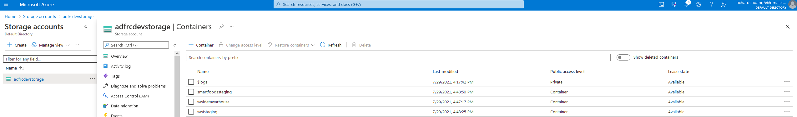
Step 1: Set up containers and databases in Azure

Slide 2
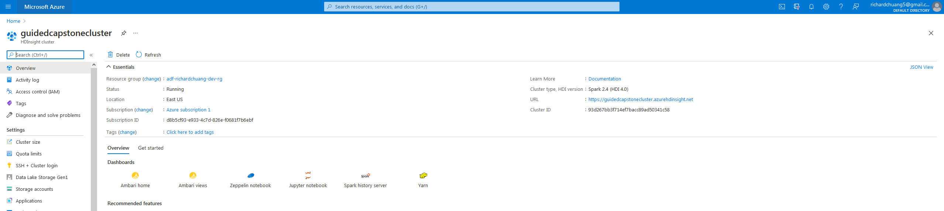
Step 2: Cluster set up. Leveraging guided capstone resources so as to not accumulate charges.

Slide 3
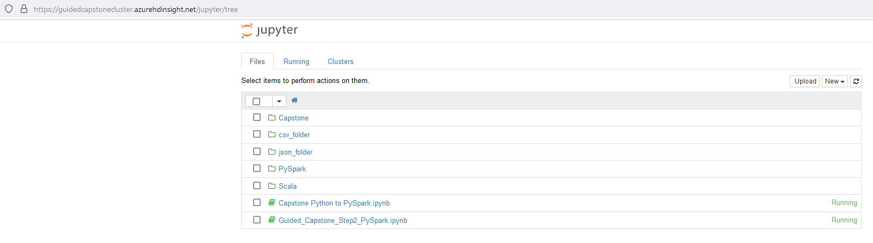
Step 3: Set up Jupyter Notebook and Capstone related files in the HDInsight cluster.

Slide 4
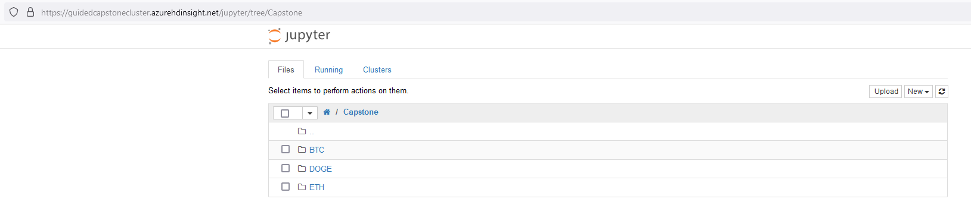
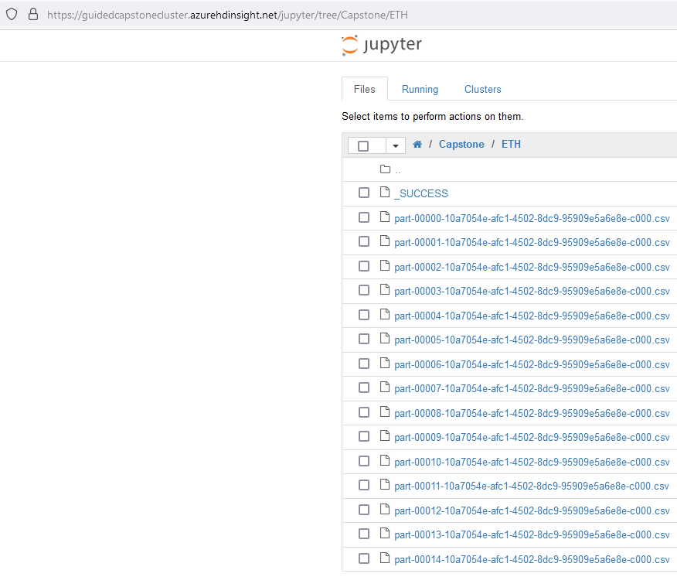
Step 4: Saved files

